Slide 1
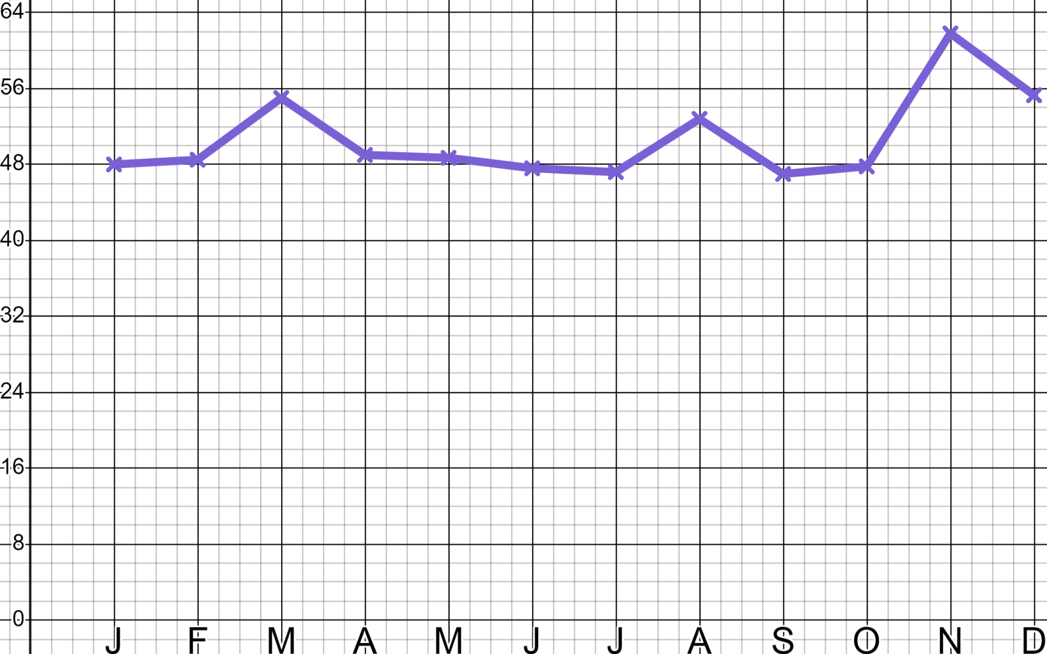
Sales and marketing
Task A: Maths in marketing
1) ‘Sam’s Sleepwear’ is now well established in the bedwear marketplace. On three occasions in this year they spent just under £5000 on online advertising campaigns.
When were those campaigns?
Which one was the most effective?
How do you know?
Site visits (000’s)
Month

Slide 2
Sales and marketing
2) ‘Sam’s Sleepwear’ is now well established in the bedwear marketplace. They spend the below on advertising and generate 14 000 extra visitors to their website.
YouTube advert
(28%)
YouTube £1100
Direct email £350
Facebook £500
Google £2500
Google
advert
(38%)
They now make a sale from 1 in 40
visitors and an average of £14 per sale.
Facebook advert
(16%)
Direct email
(18%)
Calculate which form of media is the most profitable and advise Sam as to where to spend their next advertising budget.

Slide 3

Sales and marketing
Task B: Maths in sales
1) Jun is CEO of a sweet manufacturer that sold 36 000 packets of sweets last year at £1.80 a packet. Their manufacturing cost is £0.60 per unit.
a) Calculate Jun’s current revenue and profit.
b) If Jun could double his sales by halving his price should he?
c) If Jun could increase his sales by a third by reducing his price by one third should he?

Slide 4
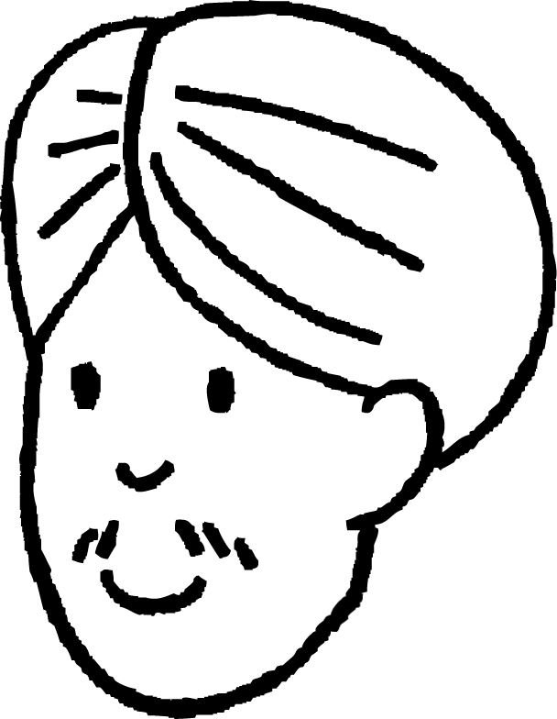
Sales and marketing
2) Andeep is a commercial accountant for a guitar manufacturer that sells 1200 units a year at £600 per unit and costs £480 per unit to make.
Which of the below are good commercial deals?
a) 5% uplift in sales for a 10% drop in price?
b) 50% uplift in sales for a 15% drop in price?
c) 10% drop in sales for a 5% increase in price?
d) If Andeep were to drop his price by 12% what percent uplift in sales would he need to see to maintain his existing profit?
Mathematics in Education and Industry
v2.4

